Slide 1
DSC640 Weekly Assignment
Week 7 & 8
Edris Safari

Slide 2
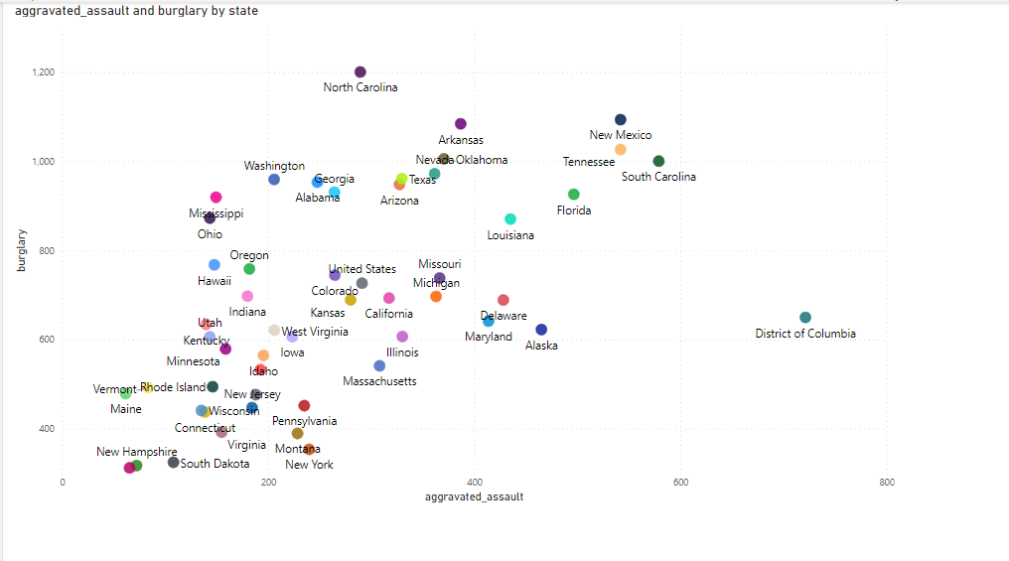
PowerBI Scatter

Slide 3
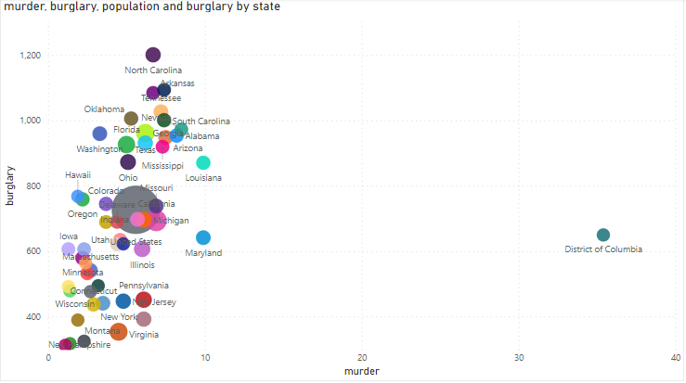
PowerBI Bubble

Slide 4
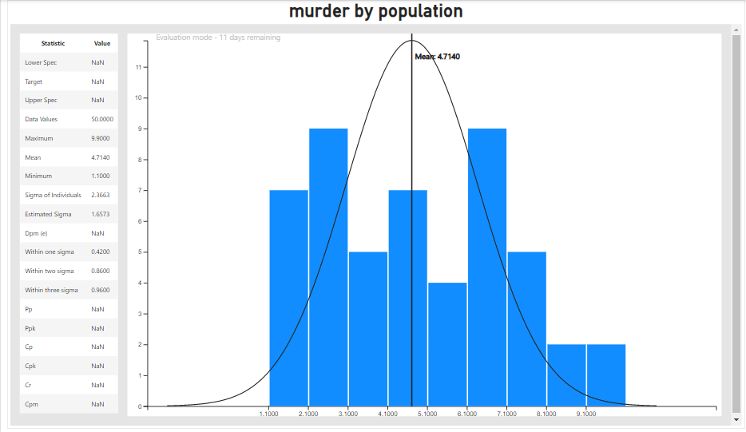
PowerBI Density

Slide 5
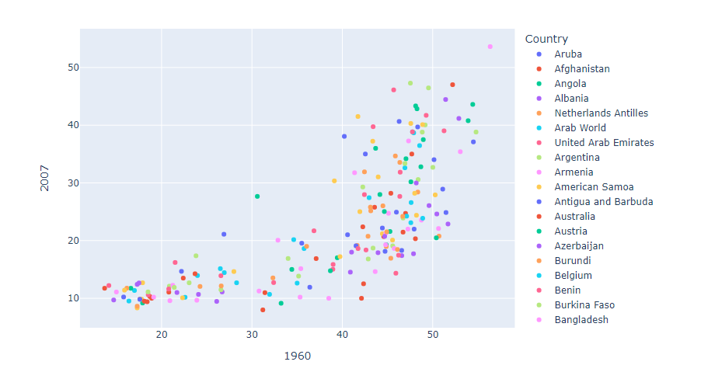
Python Scatter

Slide 6
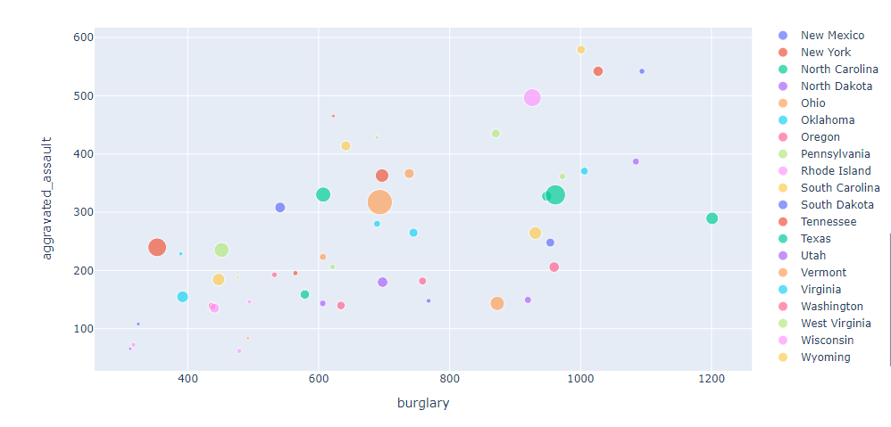
Python Bubble

Slide 7
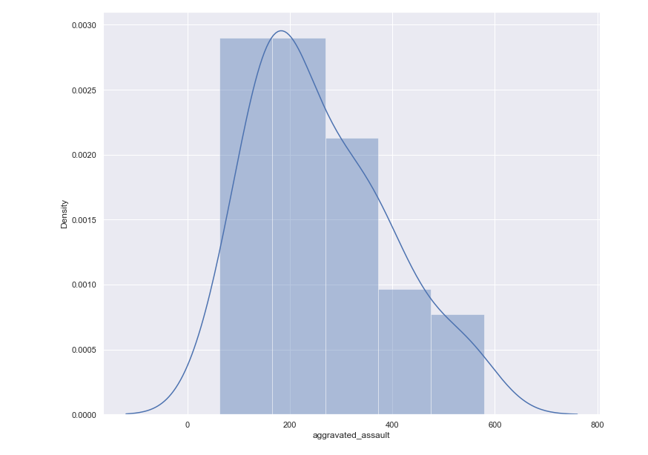
Python Density

Slide 8
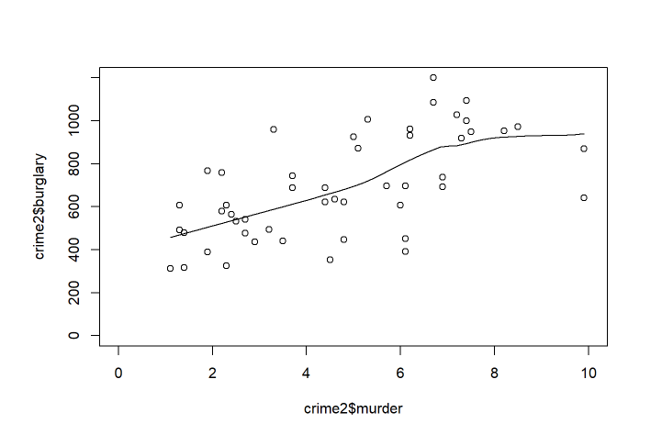
R Scatter

Slide 9
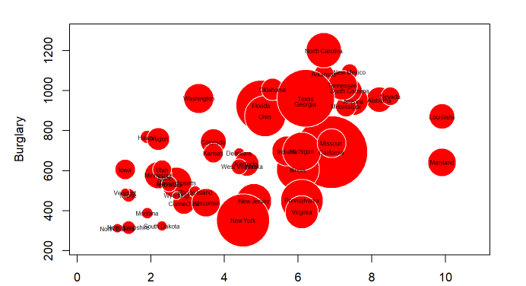
R Bubble

Slide 10
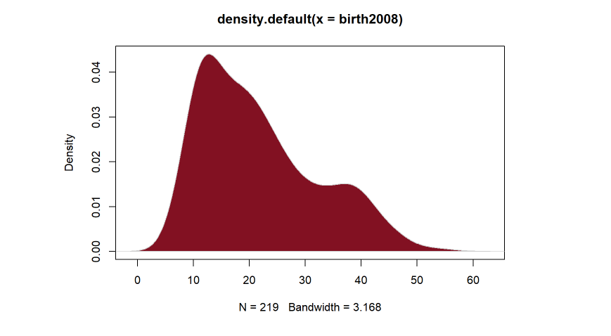
R Density

